Slide 1


TechE
CGC_REBOUNDER

Slide 2


Slide 3
CONTENT
Use-case model.
Flowchart.
Bluetooth Chipset.
Design.
Formulae.
Algorithm.
Working.

Slide 4
USE-CASE MODEL

Slide 5
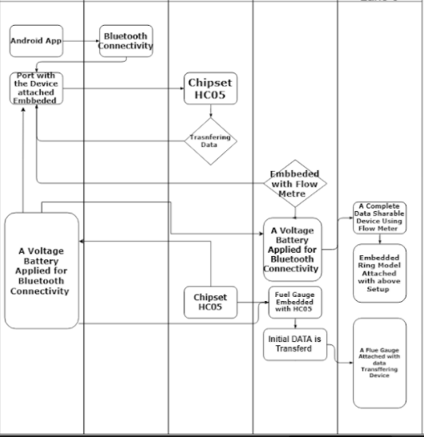
FLOWCHART

Slide 6
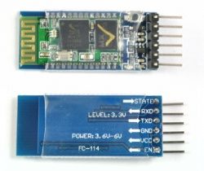
BLUETOOTH CHIPSET
HC‐05 module is an easy to use Bluetooth SPP (Serial Port Protocol) module.
Designed for transparent wireless serial connection setup.
Software Features:
Slave default Baud rate: 9600
Data bits:8
Stop bit:1
Parity : No parity
Auto‐connect to the last device on power as default.
Permit pairing device to connect as default.
Auto‐pairing PINCODE:”1234” as default.

Slide 7
DESIGN

Slide 8
Formulae

Slide 9
ALGORITHM

Slide 10
WORKING
Open The App And Click On Start
Sharing Of Data
Android API
Bluetooth API
HC-05
Embedded system data
Fuel Gauge
Pair The Device
Collecting The Data

